Slide 1
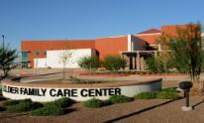
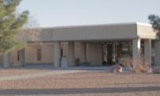
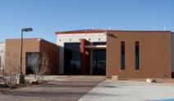
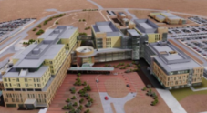
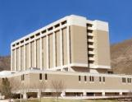
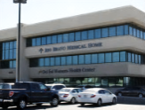
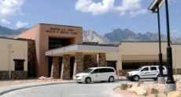
WBAMC Patient and Family Partnership Council (PFPC)
June 6, 2024 10:30 a.m. to 11:30 a.m.
Clinical Assembly Room (CAR) Room A1500B

Slide 2
AGENDA
  Welcome
  General Information
  Pharmacy – ID Card Information & Genesis (locating the locker option)
  Primary Care – School Physicals and Rio Bravo Services
  Exceptional Family Member Program – CS Improvements
  TRICARE Information – DME
  Veterinary Services – Available services
  Questions/Closing
  Hospital Commander/CSM

Slide 3
Upcoming Events
19 Jun 2024 – Juneteenth Holiday – all outpatient services closed
4 July 2024 – Independence Day Holiday – all outpatient services closed
*The Emergency Department is always available if you need immediate medical attention 24 hours a day. If you are uncertain of whether or not you should go to the Emergency Department, you can always contact the Military Health System (MHS) Nurse Advice Line at 1-800-874-2273 to find urgent care, get health care advice, or get recommendations on the appropriate level of care.

Slide 4
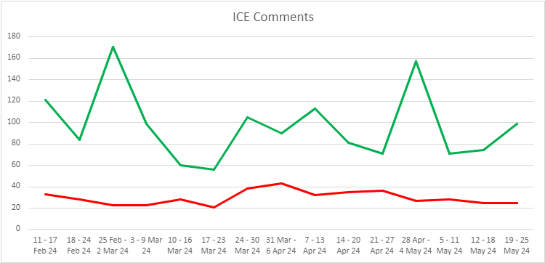
Patient Satisfaction
Joint Outpatient Experience Survey (JOES):
Satisfied with Healthcare – 89.8% the last quarter (Previous quarter 91.1%)
Recommend the Hospital – 87.9%the last quarter (Previous quarter 88.7%)
TRICARE Inpatient Satisfaction Survey (TRISS):
Results will be released 10 Jul 24 for 2nd QTR FY24
Interactive Customer Evaluation (ICE) System:
1076 satisfied and 445 dissatisfied (11 Feb – 25 May 24)
Access to Care
Customer Service
EFMP

Slide 5
The DHA is the first federal health system to participate in Leapfrog Group surveys.
Although we have long participated in the hospital and ambulatory care surveys, this is the first year that our Hospital Safety Grades are being published. The Safety Grade is a composite score made up of 22 national performance measures of patient safety and the grade represents how well hospitals protect patients from preventable errors, injuries, and infections.
Leapfrog published the 2024 Safety Grades, and 21 of our MTFs in the United States are reporting their grades.
43% of our MTFs have achieved an A grade: William Beaumont Army Medical Center was one of those MTFs!

Slide 6
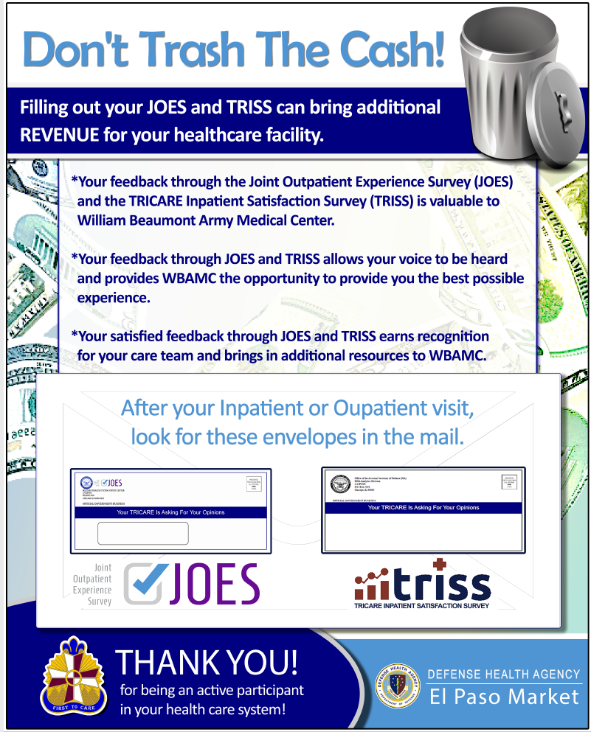

Slide 7
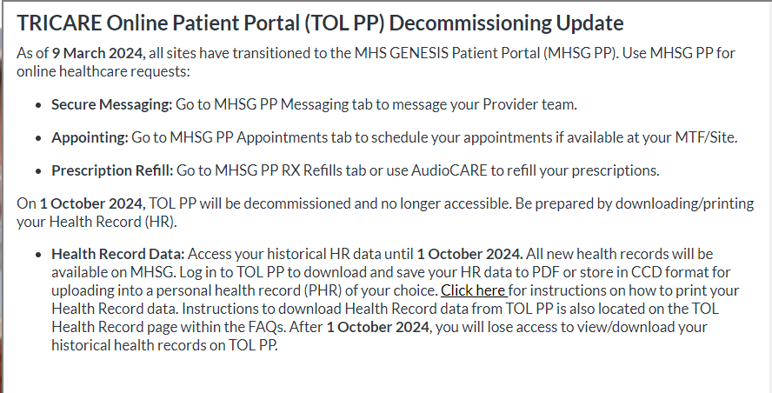

Slide 8
Information Desk 915-742-7777 – Monday to Friday 24 hours – general information only; maps and phone books are available at the front desk
Wheelchairs (regular and electric) can be signed out at the front desks in the East Clinic (Monday through Friday 0730 – 1630) and the Rotunda (Monday through Friday 24 hours a day). If needed after hours, please contact security
MHS Genesis Portal navigation assistance – please contact the Patient Experience Department
915-742-2692

Slide 9
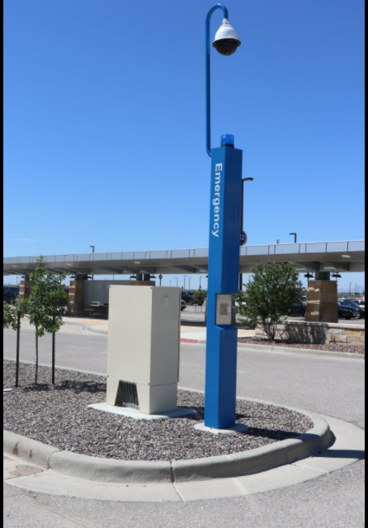
Although we have a huge parking lot, did you know you can use the Emergency and Assistant Stations (E&A Stations) to call someone to assist you for pick up? If you find yourself parked in an area where you may have difficulty walking to the hospital, simply look for one of these E&A Stations, and push the button for service. Assistance will be provided to help you reach the facility. There are 32 stations located through our parking lot.

Slide 10
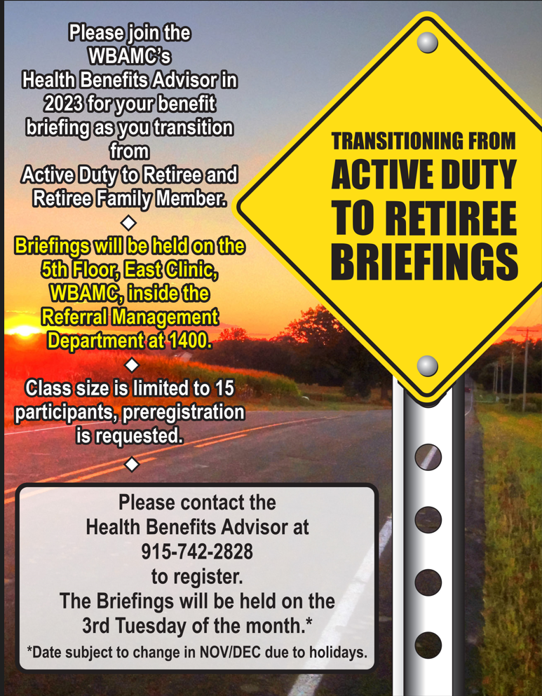

Slide 11



Slide 12
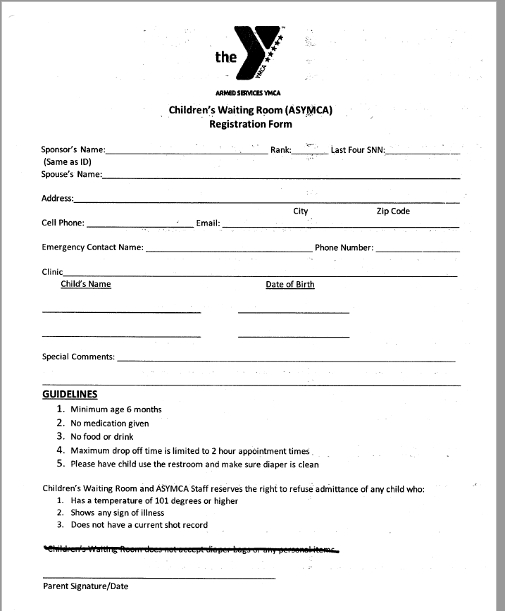
Registration is seamless – this form is all that is required:

Slide 13
Tracking Log
Task | Task/Action | status
Parking Concerns | Parking Policy | New policy is pending implementation date.
Shuttle | Consistent Parking Lot Shuttle Availability | Request to purchase shuttle submitted 26 Apr 24

Slide 14
PHARMACY
https://william-beaumont.tricare.mil/Health-Services/Pharmacy

Slide 15
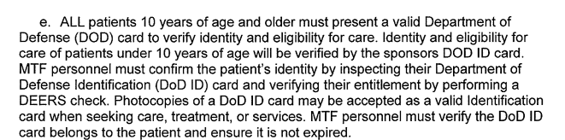
Identification requirements
If you don’t have a DoD ID:
Identify Patient and Verify Eligibility ALL patients must present valid photo identification to verify identity and eligibility for care. Ø Patients presenting for care must present a valid photo identification card (ID) such as a military ID, driver’s license, or school ID card. A military ID card is preferred, but not required. Patients without a valid ID card may proceed to Patient Administration for Defense Enrollment Eligibility Reporting System (DEERS) proof of eligibility. Ø Front Desk Staff will always verify the patient’s identity by asking them to repeat their full name with suffix, if any, and Date of Birth (DOB). The DoD ID number is located on all ID’s and should also be verified. Ø Front Desk Staff will always view DEERS in CHCS to verify eligibility for care in DEERS on each patient presenting for care. If the patient is ineligible in DEERS, but has paperwork verifying eligibility for care, patient must report discrepancy to the Patient Administrative Division to have healthcare coverage corrected.

Slide 16
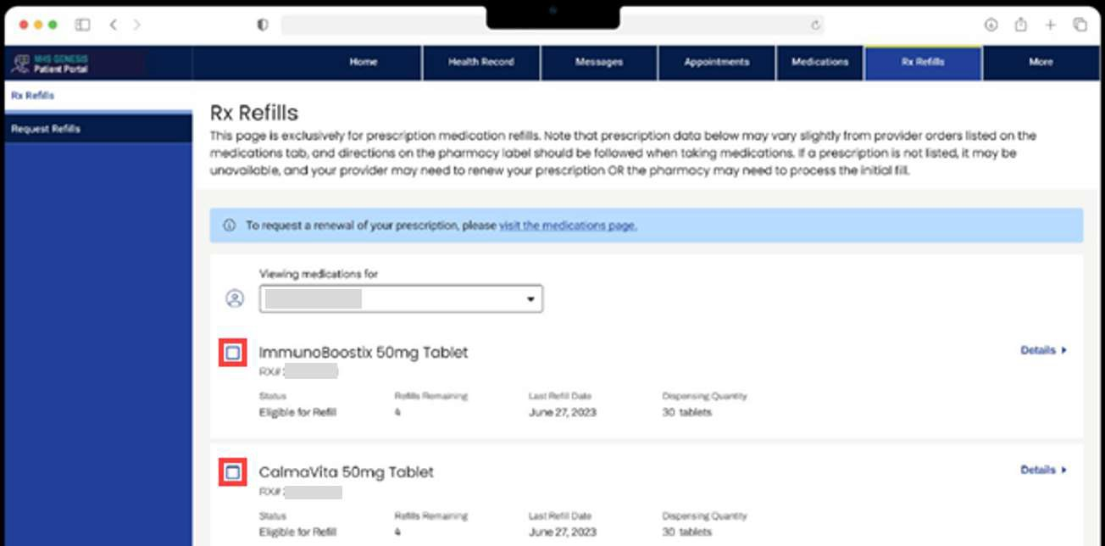
Request a Refill
After confirming the patient is logged in to the Patient Portal (https://my.mhsgenesis.health.mil):
1. Patient will click Rx Refills.
Medication Statuses that are displayed in the Rx Refills tab:
Eligible for Refill medications are displayed with a check box and may be selected by the patient.
Other statuses of medications that are displayed without a check box and cannot be refilled by the patient from the Patient Portal include:
  In Process
  On Hold
  Too Early to Refill
  Pending Patient Pick Up
2. Patient will check the boxes of medications for refill.
3. Patient will need to verify the medication details are correct.
Patient Portal Medication Refills and Renewals

Slide 17
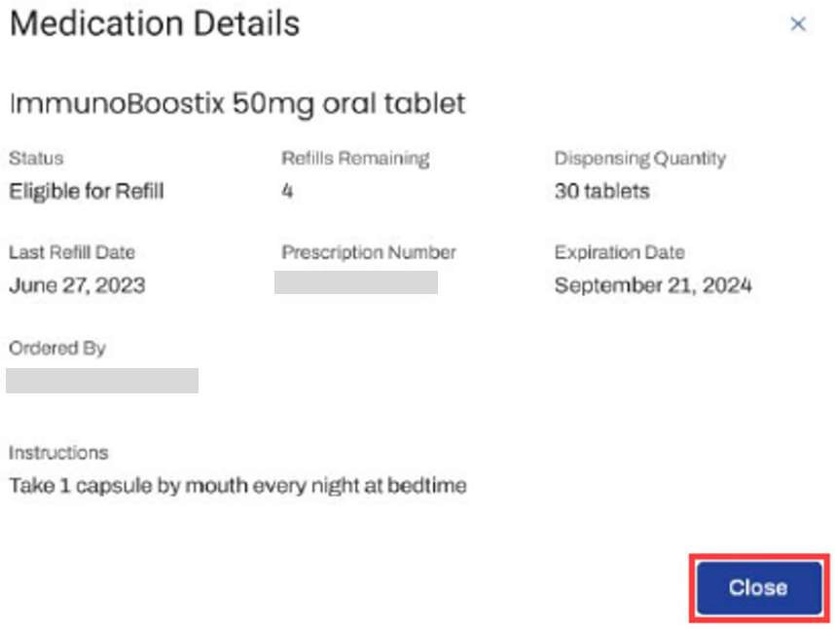
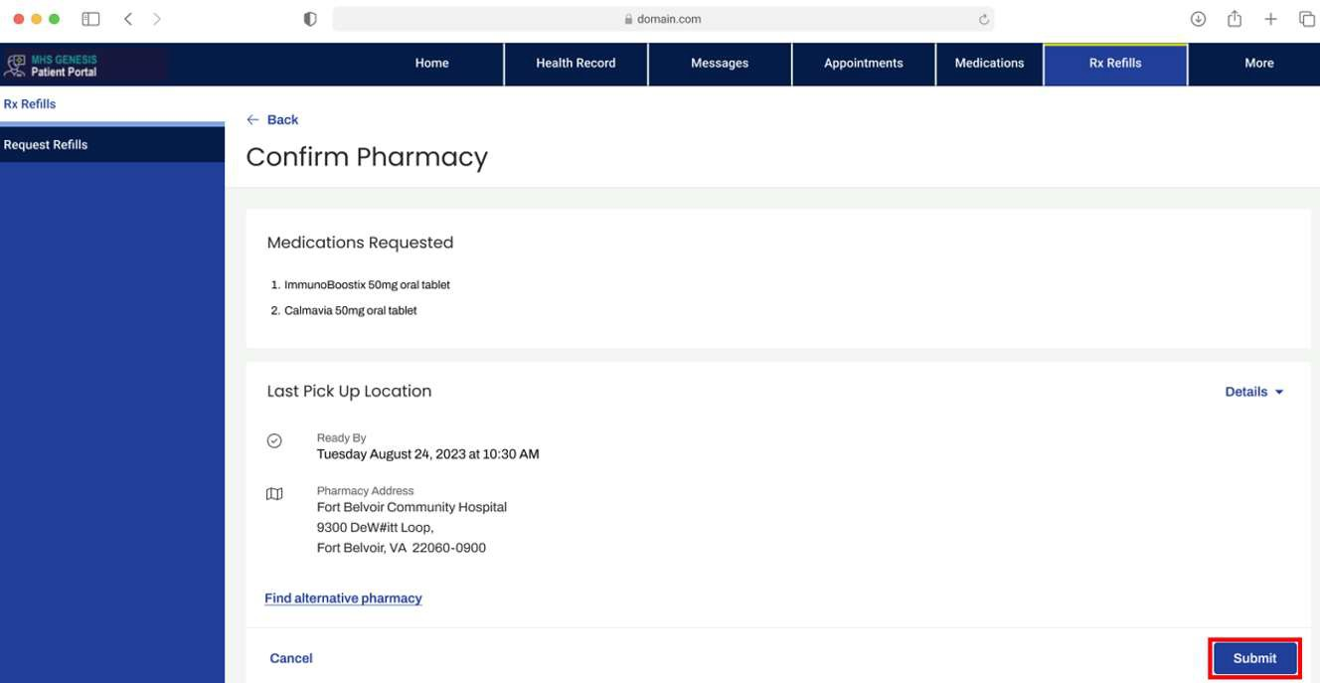
4. Patient will click Close.
Patient will click Next.
Patient will need to verify the pickup location is correct.
  If the desired pickup location is displayed, then the patient will need to click Submit and proceed to Step 9.
Note: Patients only have the option to select a Department of Defense (DOD) or a U.S. Coast Guard (USCG) pickup location; however, prescriptions initially filled at Department of Veterans Affairs (VA)/USCG/DOD pharmacies are displayed for the patient.

Slide 18
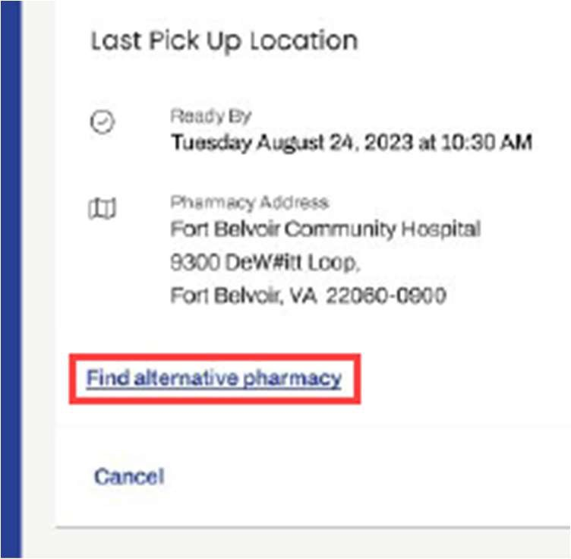
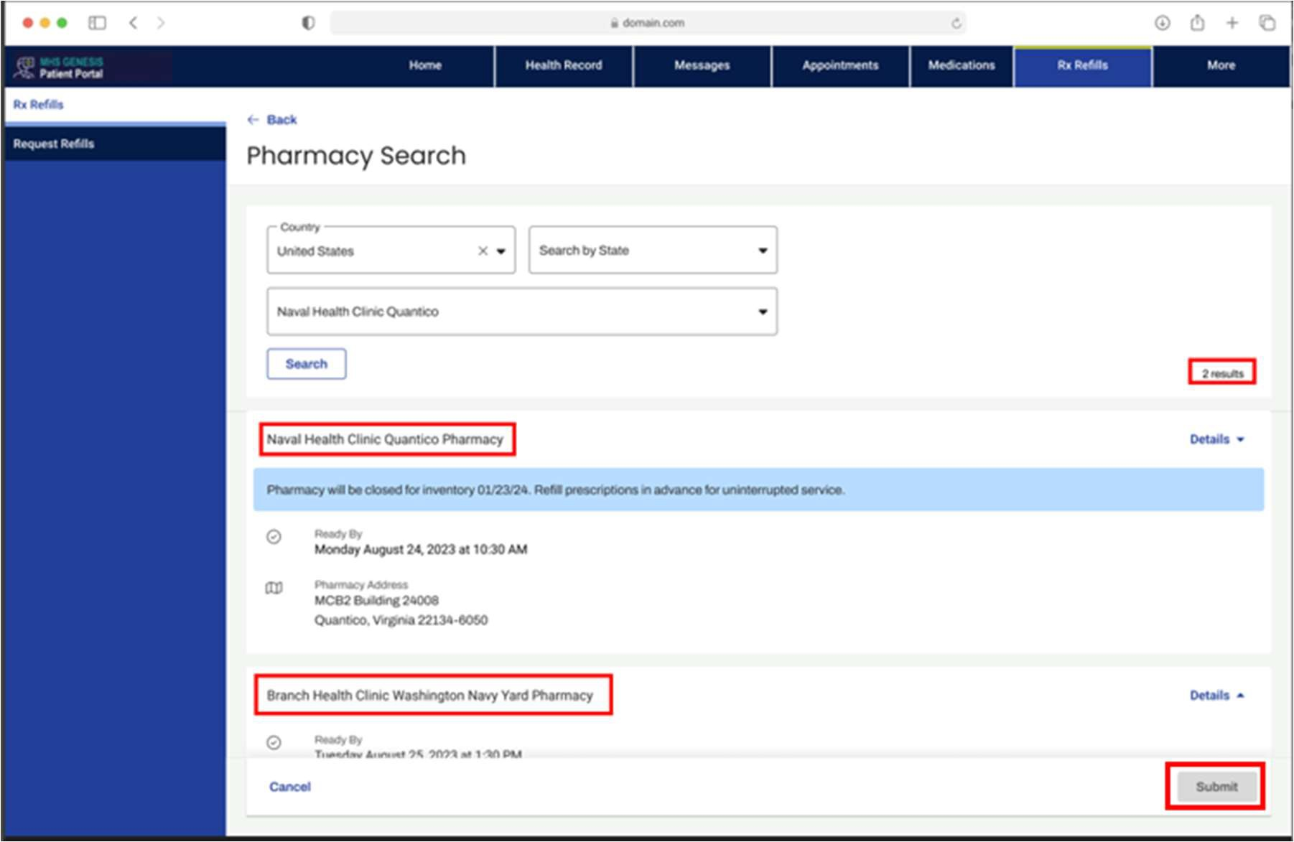
If an alternative pickup location is desired, then the patient will need to click the Find alternative pharmacy link.
  After the patient clicks the link, a Pharmacy Search section is displayed that enables the patient to search by Country, State, and Military Treatment Facility (MTF).
Patient will need to select the appropriate pickup location.
  MTFs may have multiple pickup locations.
After the patient selects a pickup location, they will need to click Submit.
Patient Portal Medication Refills and Renewals

Slide 20
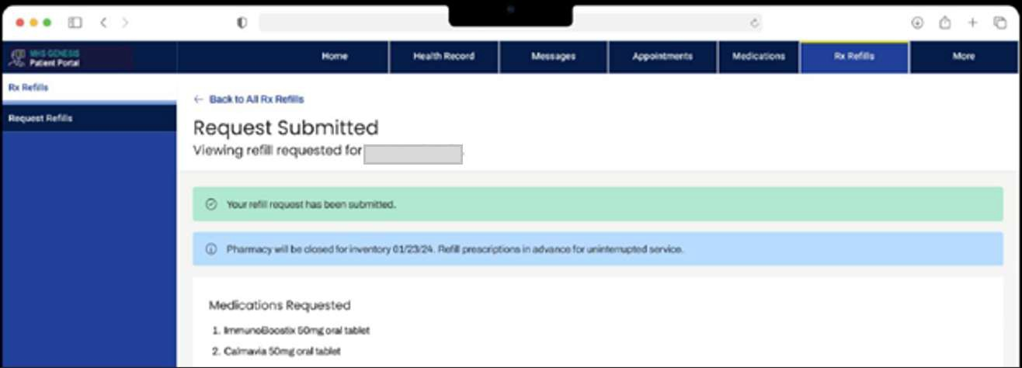
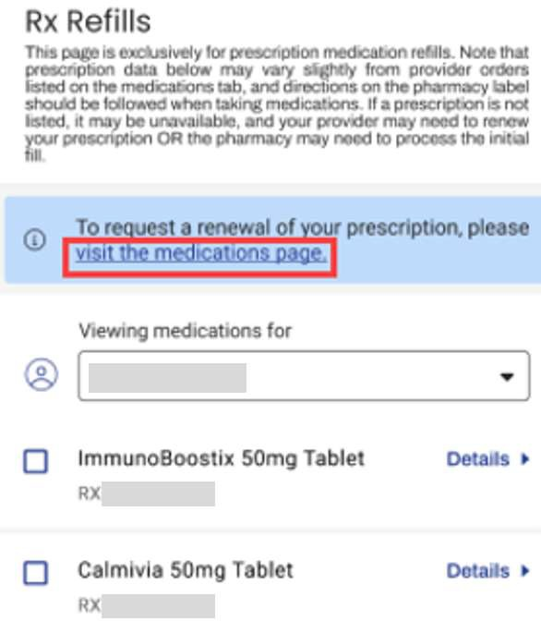
10. After the patient clicks Submit, the Request Submitted section is displayed.
Note: If the selected information is inaccurate, the patient will need to click Cancel and search for the correct location.
Request a Prescription Renewal
After logging in to the Patient Portal, the patient will select Rx Refills and then click the visit the medications page link.
  Alternatively, the patient can click the Medications tab.

Slide 21
Primary Care

Slide 22
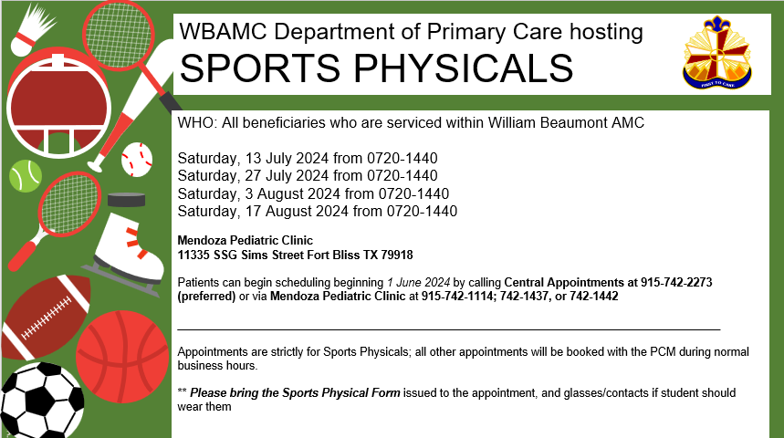

Slide 23


WBAMC Department of Primary Care Community Based Medical Homes Services
WHO: All beneficiaries who are serviced within William Beaumont AMC
Availability for empanelment at the West Side location (Desert Sage Medical Home) to Greenhoward.
Behavioral Health Consultant and what Resources/classes they provide.
The one-day addition per week of care by our Pharm D and what services will be provided at RBMH by Dr Showery starting in July.

Slide 24
Exceptional Family Member Program

Slide 25
Exceptional Family Member Program
(EFMP- Medical) is MOVING
July 15th 2024 EFMP Medical office is moving to WBAMC (18511 Highlander Medics Street)
3rd Floor West Clinic
Dual coverage (Mendoza and WBAMC) EFMP Medical Services will be available July 1st – July 12th.
WBAMC and 1AD PAO messaging online/ social media
NEW OFFICE HOURS: Effective 15JUL2024
Monday- Thursday 0730-1530, front desk is open for lunch.
  Closed 2nd and 4th Thursday/ month (1300-1600)
  Closed on Fridays/ Federal Holidays
Walk-ins are welcome
EFMP Medical Email- is active/ does not accept PII/ PHI
    wbamc.mbx.efmp@health.mil
  EFMP Medical Voicemail 915-742-3715
EFMP Family Brief
  Currently paused due to low attendance
We know the system, we CAN help!
  Request Travel Screening, Enrollment, Track EFMP account ect. Online @
  https://www.efmp.army.mil

Slide 26
E-EFMP
E-EFMP
CHALLENGES
  Telephone messages/ Voicemail/ Email response time
    Added 1 RedCross Volunteer; Added 1 ADSM
    Please ensure you leave a message and a contact number
  Education support for EFMP FMs during PCS season/ Navigation with OCONUS moves
    ACS System Navigators can assist
    1 system navigator is assigned per BDE
  ATC in MTF and network for EFMP appt
    Added ADSM NCM (through July)
    EFMP NCM/ Medical Director and Deputy level assist for appointments in MTF/ Network
  Closing referrals **
  Timeline for packet processing
    Unaware of process
    EFMP Medical, MRC-W, OCONUS location
    Proactive approach with 1AD engagement for 12mo glidepath for upcoming movers/ NCOCoE
  General Education about E-EFMP system
    Embedded education modules in E-EFMP once you log on
    Possible return of family brief during high volume time
  Annually, PCMs should be checking for qualified EFMP conditions **
    EFMP Medical provides annual training to PCMs and Specialty Providers
  DS Logon for FMs/ Q&A factsheet available at the EFMP front desk and online tricare.com (Using a DS Logon | TRICARE )
    SM can create a DS logon for dependents with unique email address

Slide 27
TRICARE/DME

Slide 28
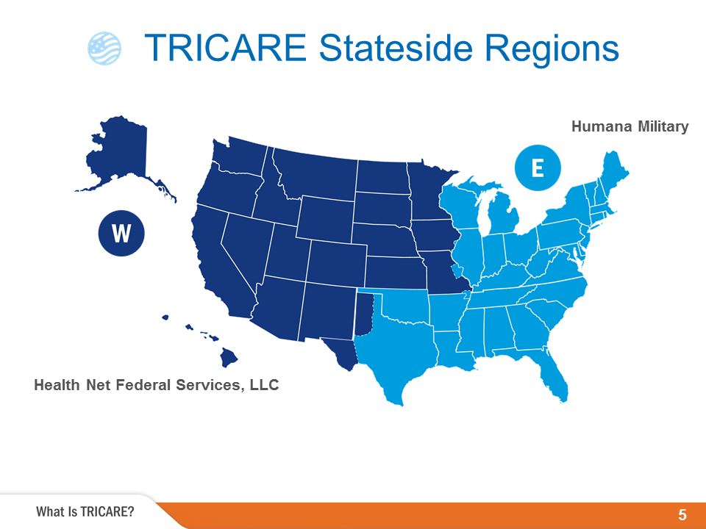
TRICARE Stateside Regions
Notes:
TRICARE is available worldwide and managed regionally. There are two TRICARE regions in the United States—TRICARE East and TRICARE West—and one overseas region with three areas—TRICARE Eurasia-Africa, TRICARE Latin America and Canada, and TRICARE Pacific. Benefits are the same regardless of where you live, but there are different customer service contacts for each region.
Health Net Federal Services, LLC administers the benefit in the West Region and Humana Military administers the benefit in the East Region. Both regional contractors partner with the Military Health System to provide health, medical, and administrative support including customer service, claims processing, and prior authorizations for certain health care services.
Contact information for each region will be provided at the end of this presentation.
Each regional contractor has a website and call center to help with your questions.
Separate contractors administer TRICARE’s dental and pharmacy benefits.

Slide 29
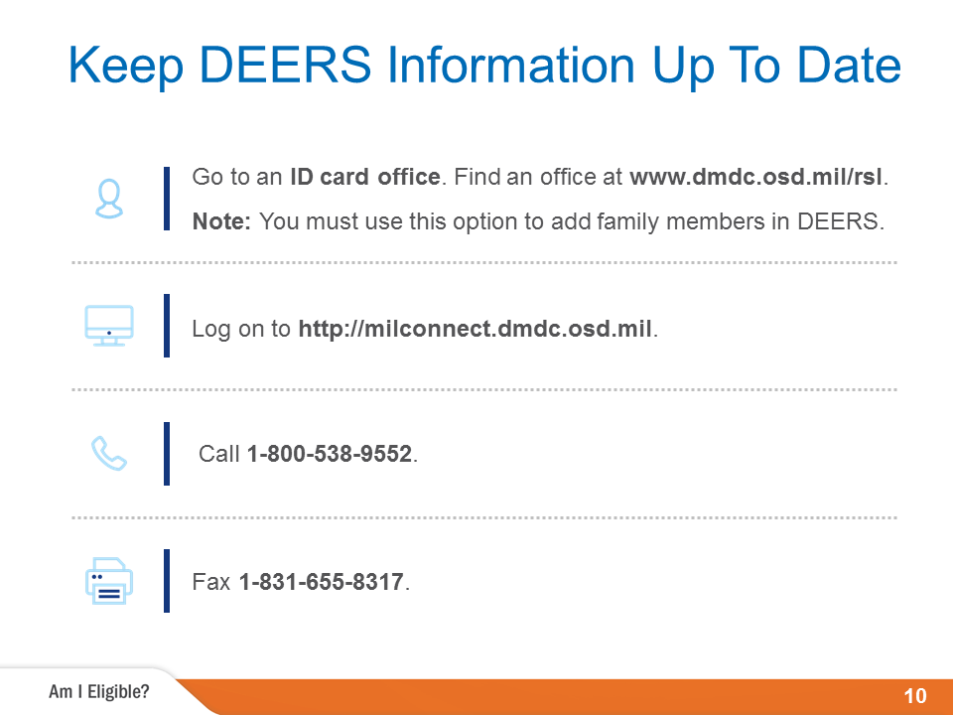
Keep DEERS Information Up To Date
Notes:
You must be registered in the Defense Enrollment Eligibility Reporting System, or DEERS, to use TRICARE. DEERS is a database of service members and dependents worldwide who are eligible for military benefits. After you are registered in DEERS, you can get a uniformed services ID card.
Sponsors are automatically registered in DEERS.
Sponsors must add their family members in DEERS for them to use TRICARE. If a sponsor is not available, a person with power of attorney from the sponsor may add family members to DEERS.
To add family members, go to an ID card office. You can find an office at www.dmdc.osd.mil/rsl.
You must have appropriate paperwork, such as a marriage certificate, birth certificate and/or adoption papers.
Once added, family members age 18 and older may update their own contact information.
You must update DEERS when you have life changes, such as moving, getting married or divorced, or adopting or having a child.
Check your eligibility and update your contact information at http://milconnect.dmdc.osd.mil. You can also update your information by phone or fax or by going to an ID card office.
For more information, visit www.tricare.mil/deers.

Slide 30
DURABLE MEDICAL EQUIPMENT (DME)
TRICARE defines DME as an item that can withstand repeated use.
Serves a medial purpose
And not generally useful to someone who isn’t sick or injured.
TRICARE covers DME only when prescribed by a provider.
The DME must improve, restore, or maintain the function of a body part, or help conditions from getting worse.
Maximize your ability to function.
Provide the right level of performance and quality for your condition.

Slide 31
TRICARE Also covers DME customization or attachments if your provider decides these are medically necessary or appropriate for your condition.
EX: TRICARE may cover a car lift for a wheelchair user.

Slide 32
DME Repairs, Replacement and Maintenance
TRICARE covers DME replacement in the following cases:
There is a change to your physical condition.
The DME is damaged.
The DME no longer works and can’t be fixed.
The US Food and Drug Administration says it no longer meets safety standard.
If your DME requires replacement, you will need a new prescription from your provider.
TRICARE Only covers regular maintenance, such as testing or cleaning your machine, when the manufacturer requires an authorized technician to service the DME.

Slide 33
DME Cost
Copayments and cost-shares for DME vary depending on your TRICARE plan and sponsor’s status.
If you have TRICARE for Life coverage, you must follow Medicare’s rules for getting DME.

Slide 34
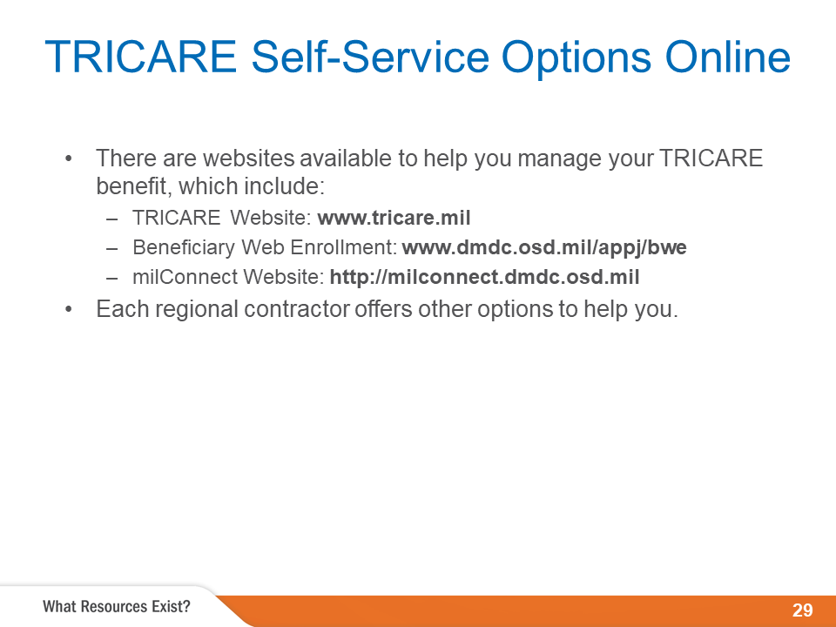
TRICARE Self-Service Options Online
Notes:
There are many self-service options to help you manage your TRICARE benefit.
You can find all the TRICARE information you need at www.tricare.mil.
The Beneficiary Web Enrollment website is a secure portal that allows you to enroll or disenroll from different program options, select or change PCMs and update DEERS contact information. For more information visit, www.dmdc.osd.mil/appj/bwe. The BWE website is not available overseas.
You can update contact information in DEERS, find an ID card office and more through the
Defense Manpower Data Center’s milConnect website at http://milconnect.dmdc.osd.mil.
Each regional contractor offers different self-service options. To find out more, go to your regional contractor's website.

Slide 35
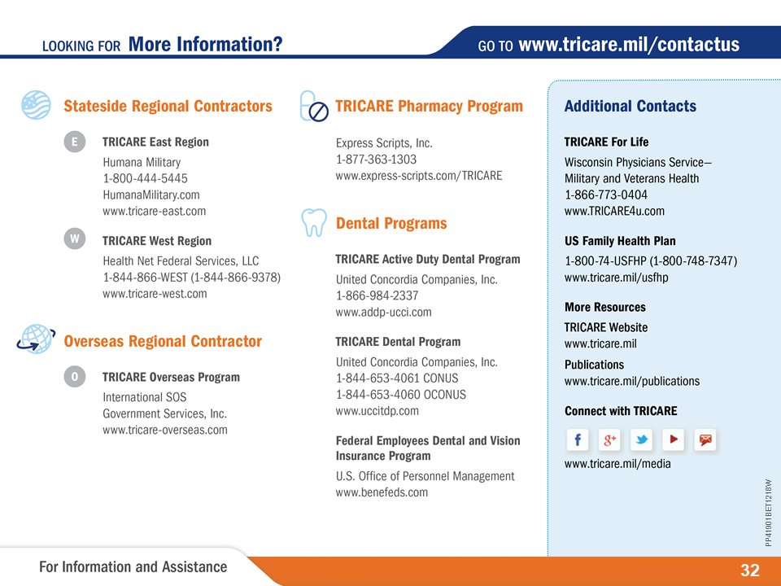
Looking for More Information?
Notes:
This slide shows contact information for stateside and overseas regional contractors, as well as other important sources for more information.
Remember, your regional contractor is based on where you live.

Slide 36
Veterinary Clinic

Slide 37
Veterinary Treatment Facility
Main Services Currently Include:
Wellness (Exams, vaccinations, heartworm tests, etc.)
Non-urgent Sick Calls (lab testing, cytology, & others)
Fluorescent Antibody Virus Neutralization (FAVN) test
Health Certificate for travel (Domestic & International)
On-Post Housing Pet Registration
For questions & to schedule appointments: (915) 742-2266
Currently located at our temporary clinic:
7305 Rodriguez St., El Paso, TX, 79930
The Fort Bliss VTF is professionally staffed by Army Veterinary Corps soldiers and civilians with the primary mission of providing complete veterinary care for all Government Owned Animals.
Due to PCS season, our services and appointment availability to all Privately Owned Animals are limited at this time. We will resume normal operations as soon as possible.

Slide 38
Next meeting will be August 15, 2024 at 11:00 a.m.
Please follow us on Facebook, Instagram and our website (william-beaumont.tricare.mil/) for the latest news and updates.
Please contact the Patient Experience Department at
915-742-2692 for recommendations or questions or if you require assistance

Slide 39
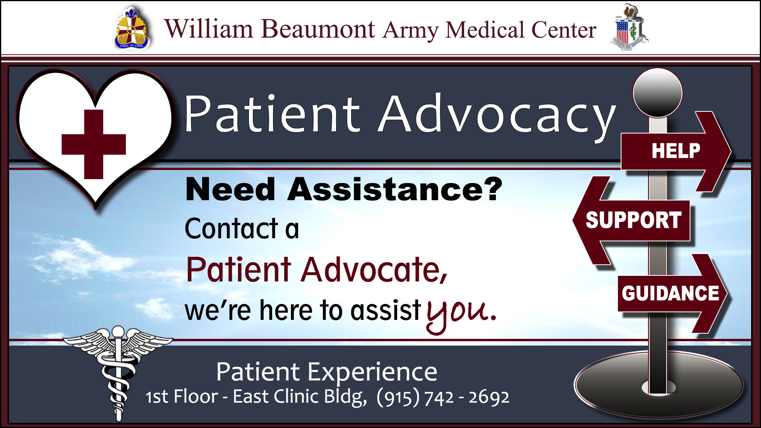

Slide 40
Questions and Discussion

