Slide 1
WBAMC Patient and Family Partnership Council (PFPC)
August 20, 2026 10:30 a.m. to 11:30 p.m.
Executive Dining Room

Slide 2
Agenda
Welcome
Upcoming Events
General Information
Tracking Log
Cardiology
Department of Primary Care Updates
Specialty Care Updates
Facilities Management Updates
Clinical Operations Updates
Red Cross
Questions/Closing
Hospital Commander/CSM

Slide 3
Upcoming Events
September 4, 2026 – minimal manning day
September 7, 2026 – Labor Day*
October 12, 2026 – Columbus Day*
November 4, 2026 at 5:00 p.m. – Patient and Family Partnership
Council (PFPC)
*All outpatient services closed
*The Emergency Department is always available if you need immediate medical attention 24 hours a day. If you are uncertain of whether or not you should go to the Emergency Department, you can always contact the Military Health System (MHS) Nurse Advice Line at 1-800-874-2273 to find urgent care, get health care advice, or get recommendations on the appropriate level of care.

Slide 4
Flu campaign information will be announced as soon as dates, times and locations are finalized.
Warfighter Refractive Eye Surgery Program (WRESP) is an elective program designed to improve the mission readiness of AD Soldiers, who wear contacts or glasses and seek to improve their eyesight. Call 915-742-9117 to inquire about the program.
School Sports physicals: Even though the School/Sports Physical program has been completed, parents can still call and schedule if there is a need. Contact your primary care provider for an appointment or call the appointment line at 915-742-2273.
Fort Bliss Veterinary Services: Fort Bliss Veterinary Care Services are back to full operational capability and are actively addressing delayed patient care resulting from the recent service gap. We sincerely ask for your continued patience as our dedicated staff works diligently to provide your pets with the high-quality care they deserve.
Children’s Waiting Rooms (CWR) are by appointment only; Please call 915-742-9926/0975. Hours are Monday to Friday 8:00 a.m. to 12:00 p.m. at WBAMC and 1:00 p.m. to 4:30 p.m. at Mendoza.
Your feedback is important; please take the time to fill out your JOES and TRISS surveys.
Visit our website for current information: https://william-beaumont.tricare.mil/

Slide 5
FIT Kit: The Defense Health Agency will soon start again in sending out FIT (Fecal Immunochemical Test) Kits. The test is a type of screening that can be used to find pre-cancerous polyps and early cancers. It is a self-administered test that can detect small amounts of blood in your stool. If you receive one in the mail, please following the instructions and mail it back. To learn more, scan the QR code!

Slide 6

Notes:
Chaperone Policy: Remember, you must be provided a chaperone for all sensitive exams, and you can request one for any appointment, at any time, for your comfort and peace of mind. Chaperones are trained, confidential healthcare staff (such as nurses, medics, or doctors) who serve as unbiased observers to protect your safety, privacy, and dignity. This policy reinforces your rights under the DoD Patient Bill of Rights, ensuring a healthcare environment rooted in respect and patient safety.

Slide 7

Notes:
TRICARE Active Duty to Retiree Briefing is every 3rd and 4th Tuesday of the month at 2:00 p.m., 5th Floor East Clinic, Referral Management

Slide 8
Cardiology

Slide 9
Cardiology – Current Improvements
Issues identified: Patients report difficulty reaching Cardiology clinic by phone
Current workflow: One MSA manages face-to-face check-in/check-out; one MSA is dedicated to phones and the Cardiology GENESIS messaging pool.
Interim staffing: Soldiers support the front desk 2–3 days/week, allowing dedicated back-clinic phone and message coverage.
Backup system: Central Appointments routes missed-call messages directly to Cardiology and remains essential when calls cannot be answered live.
Patient guidance: The checkout sheet now clearly lists how to contact the Cardiology clinic. Posters will be coming soon for waiting area.
Permanent staffing: One additional MSA and one RN are supported by leadership/PBAC; DHA approval and hiring remain pending.
Updated Coverage Model: The coverage model and redundant patient-contact pathways are implemented; performance will be monitored until permanent staffing arrives.

Slide 10
Cardiology – Device Clinic Update
Issue: Local BIOTRONIK representative attendance has been unreliable.
Resolution: Medtronic representatives will now interrogate BIOTRONIK devices during scheduled device-clinic visits.
Medtronic rep will coordinate with cardiologist and Biotronik national line if biotronic device changes requires a Biotronik rep
Outcome: Reliable device checks will continue without dependence on local BIOTRONIK representative availability.

Slide 11
Primary Care

Slide 12
Department of Primary Care
Mandatory Training Time Update
Clinical Support Standardized Protocols, VIPRR & Ambient Listening
Mental Health Consultant capabilities(**new info)
School/Sports Physical Feedback(**new info)
PHA appointment Guidance(**new info)
Acute Visit Guidance (**new info)
Appointment Challenges: No Show Appointments (**new info)
MHS Genesis Portal Capabilities & how to navigate challenges
Notes:
- Summer school physicals have been blocking one provider schedule per week in FCC to reserve for school physicals. Started on 29May2026 until 31 July 2026 Due to demand added three additional template days between 24 July and 7 August.

Slide 13
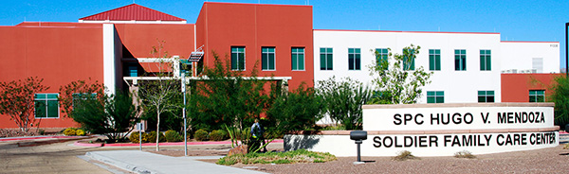
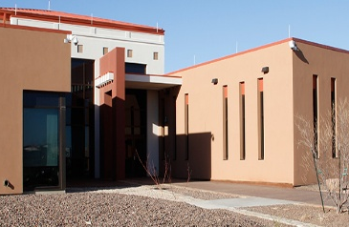
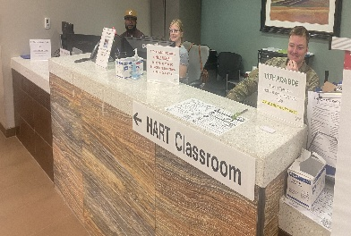
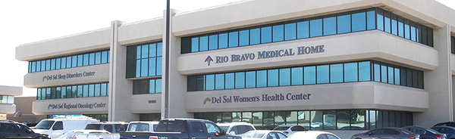
William Beaumont Army Medical Center
Department of Primary Care
Mendoza Soldier Family Care Center
East Bliss Soldier Clinic
Garrison (SFMC)- relocated to Mendoza 2nd floor
Rio Bravo Medical Home
Address:
11335 SSG Sims Rd
Fort Bliss, TX 79918
Phone:
Soldier: 915-742-2868
Family: 915-742-1107
Pediatrics: 915-742-1437
Services Available:
Lab
Radiology
Immunizations
Physical Therapy
Pharmacy
Audiology
Optometry
Address:
21227 Torch St
Fort Bliss, TX 79918
Phone:
915-742-4248
915-569-4290
Services Available:
Physical Therapy
Audiology
Radiology
Readiness (IMIP)
Immunizations
Optometry
Pharmacy
Address:
*RELOCATED to 11335 SSG Sims Rd
Fort Bliss, TX 79918
Phone:
915-742-2350
Services Available:
Lab
Radiology
Immunizations
Physical Therapy
Pharmacy
Audiology
Optometry
Address:
10460 Vista Del Sol Dr., Ste 300,
El Paso, TX 79925
Phone:
915-742-9722
Services Available:
Lab (Hrs 0700-1430)
Immunizations

Slide 14
ANCILLARY SERVICES OPERATIONAL HOURS
MENDOZA CLINIC
Mendoza Laboratory
  Monday, Tuesday, Wednesday 0700-1600
  Friday 0700-1500
  2nd and 4th Thursday closed after 1200 for clinic training
Radiology
  Daily: Monday- Friday 0730-1530; minimal staffing for lunch from 1200-1300
Mendoza Pharmacy
  Daily: Monday-Friday 0700-1630
  Freedom crossing: Monday- Friday: 0930-1800
Notes:
Mendoza Soldier Family Care Clinic has increased in serving over 11,000 additional beneficiaries with the relocation of SFMC. Humbly ask for your patience with our ancillary services support (Pharm, Lab, Rad)- as they explore innovative ways to address any care delays. To avoid extended wait times, Main Hospital William Beaumont is consistently ready to serve you in an expedited manner.

Slide 15
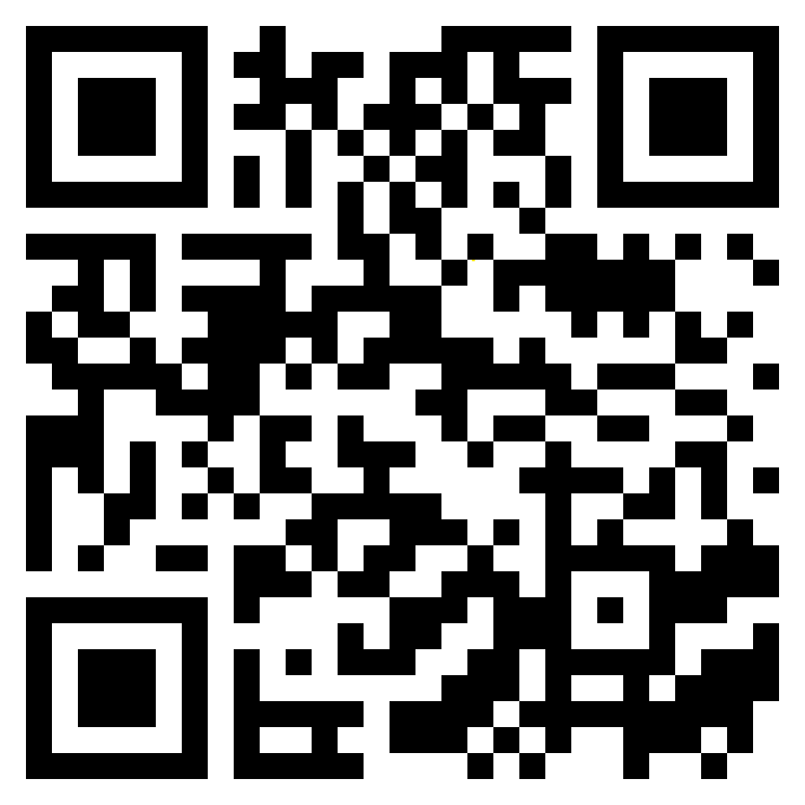
William Beaumont Army Medical Center
Department of Primary Care
Scheduling an appointment:
1. MHS Genesis Patient Portal: https://my.mhsgenesis.health.mil
2. Contact Central Appointments: at 915-742-2273 (Option # 1)
Contact clinic directly

Slide 16
Departmental Recurring Mandatory Training Time
Training time has shifted from Thursday to Friday afternoons starting end of May
  2nd and 4th Friday afternoon starting May 29
  Training time from 1300-1600 (all clinics) or 1300-1630 (Rio Bravo)
Change will affect all primary care clinics that fall within Department of Primary Care
    Mendoza Soldier Family Care Center (Pediatrics, Family, Soldier Care)
    East Bliss Soldier Medical Home
    Rio Bravo Community Based Medical Home
    Soldier Family Medical Center- Garrison
    Optometry-starting June 12
Will continue to remain open for acute issues

Slide 17
Clinical Support Standardized Protocols (CSSP)
Are you having challenges with the following and need clinical assistance but cannot get an appointment?
Sore throat
Pregnancy Test (Family & Soldier clinics)
Frequent/Painful Urination
BP checks
Suture removal
Walk into your PCMH and a nurse driven protocol can be initiated!
**Highlighted in red requires a PCM order

Slide 18
Mental Health Consultant (MHC) Support
Mental Health Consultants (MHC) – licensed mental health clinician who works directly within primary care teams to provide rapid, short-term, and solution-focused care
Embedded within each clinic
Focus areas:
  Chronic medical conditions: fibromyalgia, diabetes, hypertension, chronic pain, obesity, frequent visits without clear medical findings,
  Mental health concerns: Depression, anxiety, stress- related symptoms, ADHD, Mood worries, panic attacks, Adjustment Issues (including difficulty adjusting to Military lifestyle), PTSD
  Health behavior: smoking, poor diet, sedentary lifestyle, mild -to moderate substance use concerns ( children ,teenagers and adults), stress management
  Sleep issues: Insomnia, or poor sleep habits
  Somatic Symptoms: headaches, GI complaints , medically unexplained symptoms
  Pediatric / Family Concerns: ADHD symptoms, behavior challenges, parenting support, depression, anxiety ( social & phobias), parents’ divorce/ separation
  Life stressors: grief, adjustment to illness, family, or social stress
Psychoeducational classes every Wednesday from 1300-1330 at Rio Bravo CBMH

Slide 19

Mental Health Consultant (MHC) Support
Soldier Care Clinic Mendoza
  Dr. Valeria Garcia, LCSW
Family Care Clinic Mendoza
  Dr. Alicia Hayba, LCSW**
SFMC Family/Soldier
  Dr. Connie Ponce, IBHF, Clinical Psychologist
Rio Bravo
  Dr. Michelle Marie Gomez, LCDC, credentialed for 2 years old and above

Slide 20
Welcome to Mendoza Family Care!
New MHC Provider is currently onboarding to Mendoza Family Care
    Welcome Ms. Alicia Hayba, LCSW
Services offered:
  Chronic medical conditions, mental health concerns, sleep issues, somatic symptoms, life stressors
How to schedule an appointment:
  Reach out to your Team RN or PCM verbalize desire to see an MHC via Secure Messaging or during your appointment
  Will be ready to see patients within the next 2-3 weeks
Notes:
DPC, along with the support of Dept of Mental health; have onboarded and projected to onboard new MHC personnel. By December, our clinics are projected to have full support, with one MHC in each of our outpatient clinics

Slide 21
End of the Summer Season
Do you have feedback concerning our WBAMC Summer Sports/School Physicals offering, and challenges you may have experienced?
Send an email to Peds SHSS- Ms. Tate at teandra.l.tate.civ@health.mil who will be gathering the necessary feedback
Your feedback will shape how we administer next summer’s offering!
PCS Season:
New inbound providers
New medical providers inbound
Civilian and military
Once fully onboarded we will plan to introduce you virtually
New faces, names, and capabilities!

Slide 22
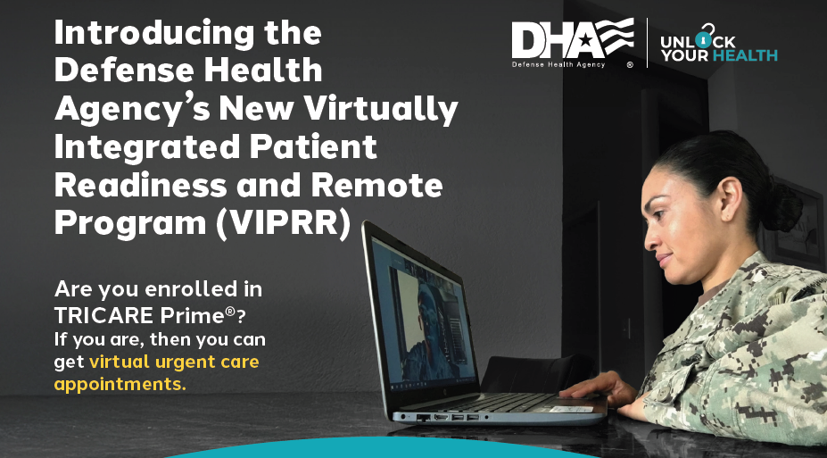

DHA’s Virtually Integrated Patient Readiness and Remote Program (VIPRR)
Are you enrolled in TRICARE PRIME?
  If you are, then you can get virtual urgent care appointments after clinic hours
  Schedule a virtual urgent care appointment for after hours and weekend needs:
    1-800-TRICARE
    Schedule between 0530-2230 CST Monday-Friday

Slide 23

Ambient Listening
Defense Health Agency is now implementing Ambient Listening into the clinical workflow
  Ambient Listening is an AI-powered clinical assistant that helps providers streamline documentation and clinical workflows through natural language interaction.
Facilitates provider to focus more on patient interaction, then documentation
  Documentation must be reviewed and verified by the clinician before finalization.
  Providers will ask for your consent prior to its usage.
  **This tool does not provide clinical decision support to the clinical provider.

Slide 24
Periodic Health Assessments (PHA)
** Please ensure Part 1 is complete prior to scheduling an appointment
Mendoza Soldier Care Clinic
  2/1 BCT Team Stryke- done by the month of the Service member’s birthday
  3/1 BCT Team Iron- Internal BDE Nurse CPT Minster, prioritizes overdue, and schedules PHAs internally virtually or in-person
  Team Marvel- make an appointment via 915-742-2273, book via virtual or in-person when need to renew
East Bliss Soldier Care Clinic
  1/1 BCT Team Gunnar- deployed but East Bliss MEDCOM provider available if needed; reach out to clinic to schedule an appointment
  Team Falcon- BDE/Unit PA has set times based on the unit, PHA rodeo’s conducted. Please contact front desk to schedule an appointment
Garrison Soldier Care Clinic
  Garrison- Please call front desk at 915-742-2350 during business hours; will schedule an appointment when need to renew
  Complete PHA rodeo’s 1st Wednesday of every month

Slide 25

Acute Care Visits
    Have you recently been seen for an acute issue in the Emergency Department or Urgent Care?
    For clinical and patient safety, expectation that timely outreach is conducted
      Expectation: next/earliest available appointment, optimally within 24-72 hours
      Opportunity to proactively address your conditions
    Active-duty service members- expectation is to report to sick call next clinic day
    Civilian beneficiaries (Adult or Pediatric)-
      Option to call 915-742-2273 to schedule an acute care visit with your PCM; please verbalize that you were seen in the ED or urgent care facility
      Secure Message Team RN to alert them of you being seen for an acute issue
Notes:
evaluate diagnostic measures completed

Slide 26
No-Show Appointments
  What is a NO SHOW appointment?
  A patient fails to arrive for a scheduled booking and does not give advance notice
  Appointment Data Trends
    Have visualized an uptick in no show appointments across all clinical areas (Soldier Care & Family Care)
    Affects access to care and challenges with accessibility for a timely appointment
  Kindly request an attempt to cancel and reschedule
    call 915-742-2273 (option 1) or log in via the MHS Genesis Portal to Cancel with as much notice as possible

Slide 27
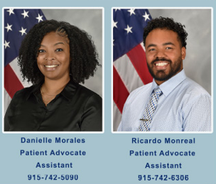
Patient Advocacy Support at Mendoza
Having an issue or concern when at Mendoza Soldier Family Care clinic?
Our Patient Advocacy team is ready to assist!
Call 915-742-1168 should you need assistance.

Slide 28
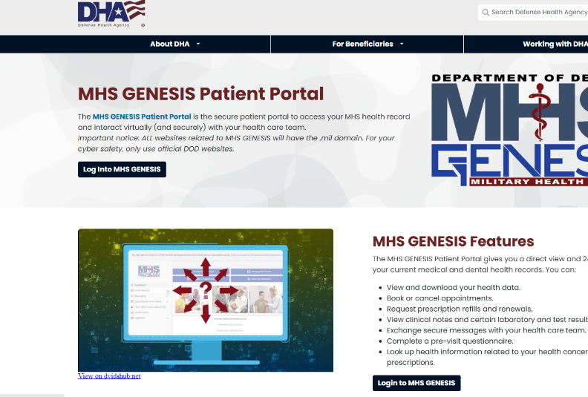
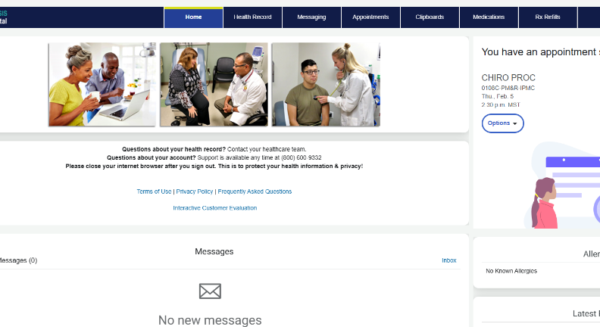
MHS Genesis Patient Portal
24/7 Access
Appointment Reminders!
Refill/Track Prescriptions
Message your Healthcare Team
Book or Change your appointments
View your Health Record
  Review Lab Work
  Review Radiology results
  Clinical notes

Slide 29
Patient Portal: Self Scheduling Challenges
Can search for appointments in two methods:
  PCM or Appointment type search (includes location)
Please carefully select your PCM under schedule an appointment by provider
Please carefully select Appointment Type
  Search will ask whether it is a Family Medicine, Internal Medicine, or Pediatric in person or Virtual appointment type
Please carefully select Appointment Location
  See next page for how clinics are listed in the portal
If PCM or location/appointment type are not selected appropriately this may contribute to delays in care

Slide 30
Location Titles for Clinical Areas in
MHS Genesis Portal
    Only one area begins with “William Beaumont AMC”.
    Remainder begin with Army Medicine
    Soldier Care Areas are managed by the clinic
  Location titles:
    William Beaumont Army Medical Center Internal Medicine Team Red Internal Medicine
    Army Medicine Mendoza Soldier Family Care Clinic Family Medicine Team Honor
    Army Medicine Mendoza Soldier Family Care Clinic Family Medicine Team Pride
    Army Medicine Mendoza Soldier Family Care Clinic Family Medicine Team Trust
    Army Medicine Soldier Family Medical Clinic Family Medicine Team SFMC A
    Army Medicine Soldier Family Medical Clinic Family Medicine Team SFMC B
    Army Medicine Rio Bravo- Bliss Family Medicine Team Rio
    Army Medicine Rio Bravo- Bliss Family Medicine Team Bravo
    Army Medicine Mendoza Soldier Family Care Clinic Pediatrics Team Minnie
    Army Medicine Mendoza Soldier Family Care Clinic Pediatrics Team Mickey
    Army Medicine Mendoza Soldier Family Care Clinic Pediatrics Team Donald
Mendoza Family Care
Clinic
SFMC Family
Rio Bravo
Mendoza Pediatrics

Slide 31
MHS Genesis Patient Portal Issues
Need help with MHS Genesis Patient Portal:
Receiving error message once logged into the portal site
  Please call 1-800-538-9552
For help with DS Logon issues, visit:
https://milconnect.dmdc.osd.mil
or call 1-800-600-9332

Slide 32
Specialty Care

Slide 33
Medical Specialties
Allergy
  Sole provider will return mid September
  Virtual Backfill only able to accommodate established patients. Allergy shots are not affected
Endocrine
  Back to normal operations with 2 providers
Rheumatology
  No Availability – Sole provider will return mid September

Slide 34
Medical Specialties
Hematology/Oncology
  Has increased capacity
  Seeing a lot more benign hematology consults.
Gastroenterology
  Decreased access Jun-Aug due to one Doc. Incoming Doc expected to be onboarded for September

Slide 35
Facilities Management

Slide 36
Facilities Updates for Patient Areas
6th Floor (Medical Unit) Repairs in progress with target completion of 2 September 2026
SFMC Roof Replacement contract solicitation process is in progress, contract award expected NLT 30 September 2026
  Clinic Renovation in planning and both roof replacement and renovation projected for mid 2027
Baby Changing signs for restrooms installed week of 3 August 2026
Restroom door adjustments ISO ADA – door closer operators adjusted for two family restrooms, automatic door operation pursued through service order
Water Filter Stations – three stations 1st floor planned

Slide 37
Clinical Operations

Slide 38
CLINOPS Updates
TRICARE Open Season - Upcoming
  TRICARE Open Season for the 2027 will run from November 11 through December 12, 2026, with coverage changes effective January 1, 2027.
Specialty Care – Patient Portal
  August – working with each specialty care clinic to establish a process for messaging and appointment scheduling.

Slide 39
Red Cross

Slide 40


JOIN!
Our support at WBAMC is only possible because of the dedication and
generosity of our wonderful Red Cross Volunteers.
Take action in supporting our service members, families and military community
by becoming a Red Cross Volunteer!
Priority Volunteer Positions are:
Information Desk, Shuttle Cart Driver, Red Cross office; we ask for one shift a week but may volunteer more if desired!
Scan QR
Code to
Apply
and/or e-mail bliss@redcross.org
Notes:
Join our WBAMC Red Cross team! We have several ways that you too can serve our Red Cross mission. We are currently in high need of Shuttle Drivers, Information Desk Volunteers, and Leadership Volunteers.
Shuttle Drivers - drive patients and visitors between the parking lot to/from hospital.
Be at least 21 years old
Have a current driver’s license and clean driving record
Be friendly and willing to offer a helping hand to assist people into and out of cart if necessary
Able to volunteer at least one shift a week (morning or afternoon); may volunteer more often if desired!
Ambassador & General Volunteers - help direct and guide WBAMC patients/visitors at reception desks.
Friendly and patient
Able to guide patients for long distances within WBAMC or assigned clinic area.
Able to volunteer at least one shift a week (morning or afternoon); may volunteer more often if desired!
Leadership Volunteers – support with program implementation and volunteer workforce management.
To become a Red Cross volunteer:
Fill out a Red Cross online application and background check at www.redcross.org/volunteer
Once your application is complete, we will call you to schedule a Red Cross Orientation and start your in-processing. All volunteers are required to Complete WBAMC-Red Cross In-Processing Steps
Questions, please reach us at 915-742-9433 or by Email: bliss@redcross.org

Slide 41
Tracking Log
Task | Task/Action | status
Shuttle | Consistent Parking Lot Shuttle Availability | Partially operational – volunteer Mon, Wed and Fri
Genesis – patient appt locations | Make the patient appt locations more patient friendly for the reminders and in Genesis | Pending – DHA Ticket Created cheat card for staff to utilize to tell patients where there appts are.
Water Filter Stations | Water Filter stations available in the hospital for patients and staff | 3 Stations 1st Floor Planned
Automatic Door Openers for restrooms | Add automatic door openers for restrooms to make the bathroom handicap accessible | Facilities has plan in place
Baby Changing Stations | Signage put on restroom doors for baby changing stations and adding changing stations to the family restrooms | Installing Week of August 3
Parking Lot Emergency Phones | Ensure all phones are working and ensure those that aren’t are marked as such | Facilities is working with PMO to address

Slide 42
Next meeting will be Nov 4, 2026 at 5:00 p.m. in the WBAMC Executive Dining Room
Please follow us on Facebook, Instagram and our website (william-beaumont.tricare.mil/) for the latest news and updates.
Please contact the Patient Experience Department at
915-742-2692/2508 for recommendations, questions or if you require assistance

Slide 43
Questions and Discussion

