Slide 1
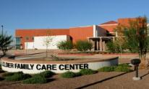
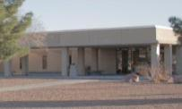
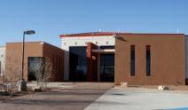
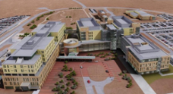
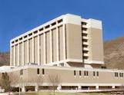
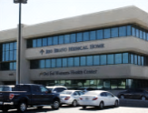
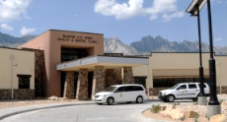
WBAMC Patient and Family Partnership Council (PFPC)
November 8, 2023 10:30 a.m. to 11:30 a.m.
Clinical Assembly Room (CAR) Room A1500B

Slide 2
AGENDA
Welcome
General Information
Pharmacy
Primary Care
Flu Campaign
Flu & COVID Prevention Tips
TRICARE – Open Season and Flu & COVID Vaccines
Questions/Closing
Hospital Commander/CSM

Slide 3
November 10, 2023 is Veterans Day Holiday – all outpatient services closed
November 23, 2023 is the Thanksgiving Day Holiday – all outpatient services closed
November 24, 2023 is minimal staffing day
December 7, 2023 at 6:00 p.m. is the WBAMC Tree Lighting Ceremony
December 22, 2023 is minimal staffing day
December 25, 2023 is the Christmas Day Holiday – all outpatient services closed
December 29, 2023 is a minimal staffing day
January1, 2024 is the New Years Day Holiday
January 12, 2024 is a training day
January 15, 2024 is the Martin Luther King Jr. Day Holiday–all outpatient services closed
February 16, 2024 is a training day
February 19, 2024 is the President’s Day Holiday – all outpatient services closed
***please verify services prior to coming on all training and minimal staffing days***
*The Emergency Department is always available if you need immediate medical attention 24 hours a day. If you are uncertain of whether or not you should go to the Emergency Department, you can always contact the Military Health System (MHS) Nurse Advice Line at 1-800-874-2273 to find urgent care, get health care advice, or get recommendations on the appropriate level of care.

Slide 4
Patient Satisfaction
Joint Outpatient Experience Survey (JOES):
Satisfied with Healthcare – 85.8% the last quarter
Recommend the Hospital – 80.8% the last quarter
TRICARE Inpatient Satisfaction Survey (JOES):
Overall Hospital Rating – 81.4% the last quarter
Recommend the Hospital – 82.7% the last quarter
Interactive Customer Evaluation (ICE) System:
1507 satisfied and 312 dissatisfied (29 Jul – 21 Oct 23)

Slide 6
Information Desk 915-742-7777 – Monday to Friday 24 hours – general information only; maps and phone books are available at the front desk
Wheelchairs (regular and electric) can be signed out at the front desks in the East Clinic (Monday through Friday 0730 – 1630) and the Rotunda (Monday through Friday 24 hours a day). If needed after hours, please contact security
MHS Genesis Portal navigation assistance – please contact the Patient Experience Department
915-742-2692

Slide 7
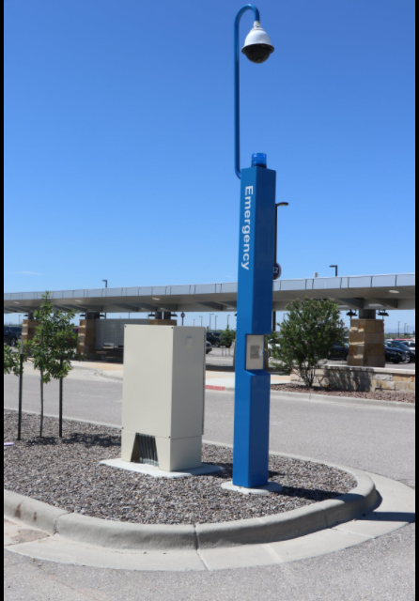
Although we have a huge parking lot, did you know you can use the Emergency and Assistant Stations (E&A Stations) to call someone to assist you for pick up? If you find yourself parked in an area where you may have difficulty walking to the hospital, simply look for one of these E&A Stations, and push the button for service. Assistance will be provided to help you reach the facility. There are 32 stations located through our parking lot.

Slide 8
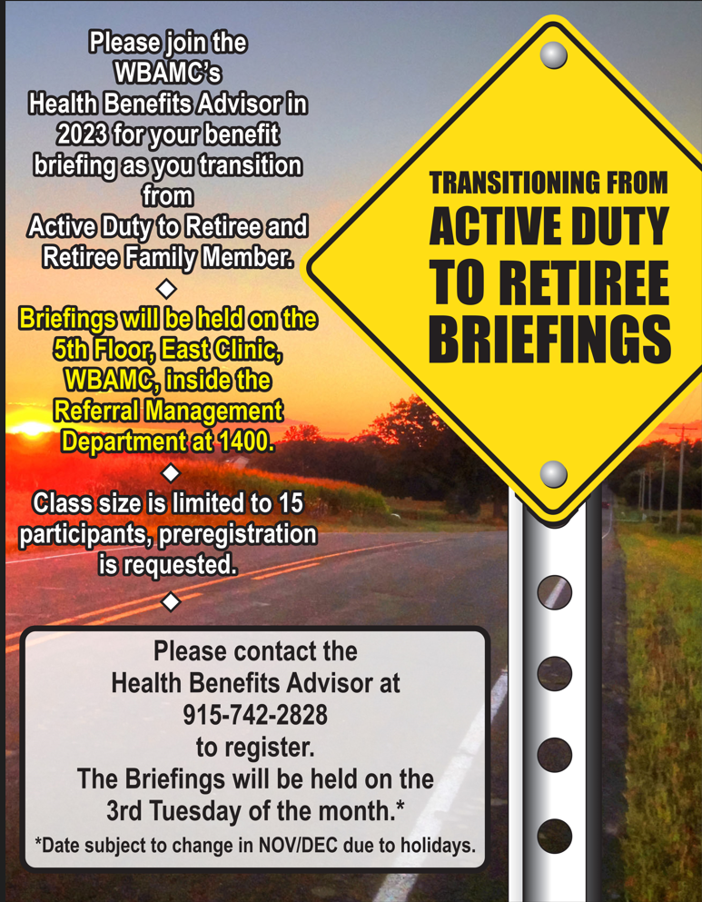

Slide 10
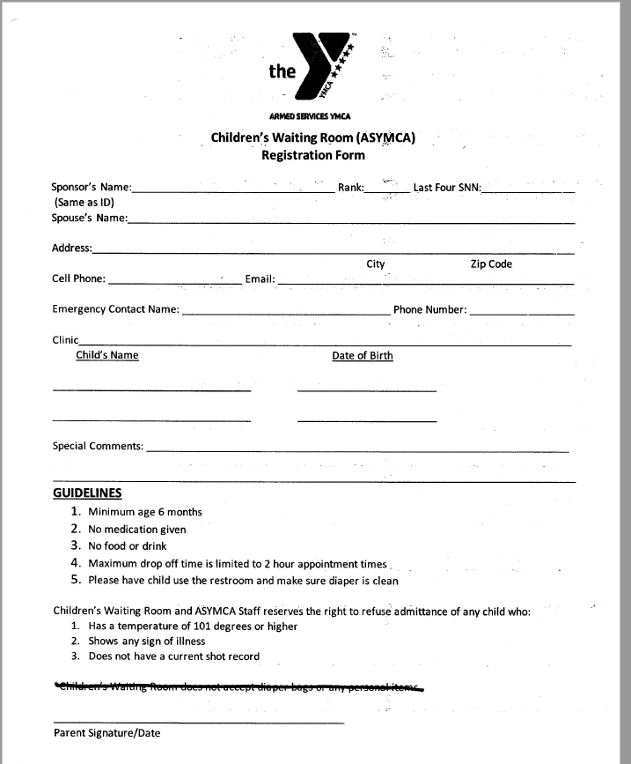
Registration is seamless – this form is all that is required:

Slide 11
Tracking Log
Task | Task/Action | status
Parking Concerns | Parking Policy | With the EOC Committee – Proposal plan will be presented 14 Nov 23
Shuttle | Consistent Parking Lot Shuttle Availability | With the DEI Committee

Slide 12
PHARMACY

Slide 13
Pharmacy Hours of Operation
Main Outpatient Pharmacy
7:30am-4:30pm
Monday-Friday
Closed Federal Holidays
Training Holiday & Minimal Staffing Hours
7:30am - 4:00pm
Mendoza Clinic Pharmacy
7:00am-4:30pm
Monday-Friday
Closed Federal Holidays
Training Holiday & Minimal Staffing Hours
7:30am - 4:00pm
Freedom Crossing Pharmacy
9:30am-6:00pm
Monday-Friday
Closed Federal Holidays
Training Holiday & Minimal Staffing Hours
8:30am - 5:00pm
East Bliss Pharmacy
7:00am-3:30pm
Monday-Friday
Closed Federal Holidays
Training Holiday & Minimal Staffing Hours
7:00am – 1100pm

Slide 14
LOCATED IN THE HALLWAY ADJACENT TO PHARMACY WINDOW 1 at FREEDOM CROSSING and the Main Hospital Pharmacy lobby
1 | Order your refills by calling 915-742-1200. Select “Option 1” for ScriptCenter at Freedom Crossing” or “Option 2” for ScriptCenter at Main Pharmacy as your pickup location.
2 | At ScriptCenter select “Enroll”. You will need one of your current prescription numbers to complete enrollment. If you don’t have a current prescription number to activate enrollment call the pharmacy at (915) 742-9017 or (915) 742-9490. Helpful tip! During Enrollment, you will have the option to create your User ID and PIN. You can also add your fingerprint and/or Military ID to use instead of your User ID. This makes logging in even easier!
2 | Review your prescriptions to pickup, sign, and complete your transaction.
Asteres Inc.
4110 Sorrento Valley Blvd.
San Diego, CA 92121

Slide 15
Self-Care OTC Medication List
https://william-beaumont.tricare.mil/Health-Services/Pharmacy

Slide 16
Primary Care

Slide 18
Exceptional Family Member Program (EFMP)
EFMP Medical office hours
Monday- Thursday 0730-1530, front desk is open for lunch, Closed Fridays/ Federal Holidays- Telephone service is available @ front desk on Fridays.
Walk-ins are welcome; document turn in/ scanning if need is by walk-in
EFMP Medical Email- is active/ does not accept PII/ PHI
EFMP Medical Voicemail 915-742-3715
EFMP Family Brief
2nd Friday/ month @ Mendoza EFMP 2nd Floor Rm S-206 1000-UTC
SSA staff will be hands on to assist any EFMP actions and Q&A
Childcare is available at Mendoza during family briefs if needed.
Updates for the EFMP Medical office can be found at
Exceptional Family Member Program (tricare.mil)

Slide 19
Enterprise Exceptional Family Member Program (E-EFMP)
https://efmp.army.mil

Slide 20
E-EFMP
E-EFMP launched 31AUG2022
ALARACT 061/2022 E-EFMP
Online system
DS Login is required for SM/ FM- benefit to access it on any mobile device, no CAC is necessary
SM can now view their requests, submit requests, and update 24/7
SM now have access to check status without coming to office
Significant improvements on workflow have been made
Effective 1APR2023, all WBAMC providers will now complete 2792s, and 2792-1s within E-EFMP system. Paper forms are accepted on a case-by-case basis.
Off-post providers will continue with paper 2792, 2792-1s.
CHALLENGES
Unaware of timeline
ATC for EFMP appts
Closing referrals
Bringing in or uploading complete medical documentation
DS Logon for FMs/ Q&A factsheet available at the EFMP front desk and online tricare.com (Using a DS Logon | TRICARE )
SM can create a DS logon for dependents with unique email address

Slide 21
Center for Autism Resources Education and Services (CARES)
Questions and Discussion
Autism resources are currently limited within the Fort Bliss community and is one of the primary reasons for EFMP PCS denials
William Beaumont Army Medical Center is currently exploring options to expand services
Staff Visit to Joint Base Lewis-McChord, Sept 2023
Development of STAT testing capabilities with providers
Assessment of network capabilities
Initiating development of internal capabilities to better meet the needs of the Fort Bliss community

Slide 22
Flu Campaign

Slide 23
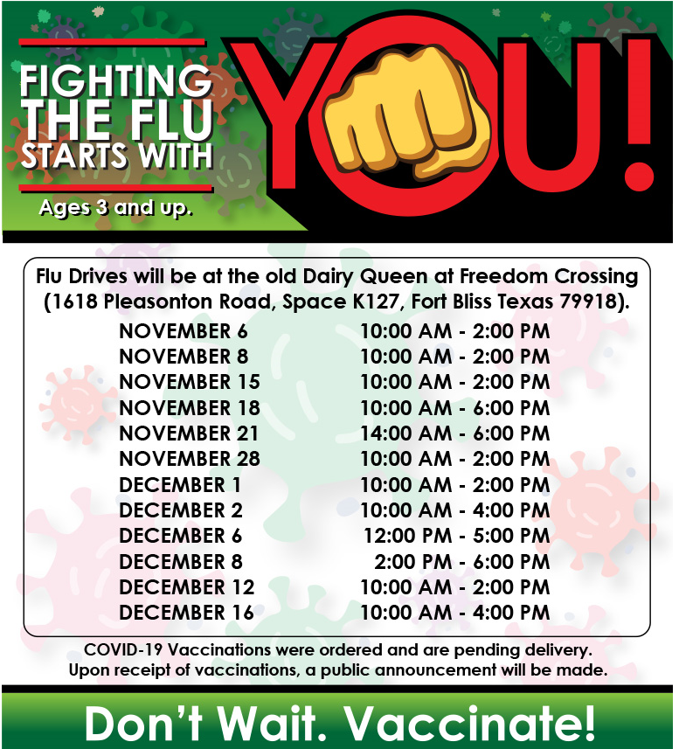

Slide 24
Flu & COVID Prevention

Slide 25
Protect yourself from COVID-19, Flu, and other Respiratory Infections
It is common to get sick from respiratory viruses such as COVID-19, flu, and respiratory syncytial virus (RSV), especially in the fall and winter times.
According to the CDC (Center for Disease Control and Prevention), There are actions you can take to protect yourself and others.

Slide 26
Symptoms of care
Vaccines
Vaccines help the body learn how to defend itself from disease without the dangers of an infection. The immunity you gain from vaccination can reduce your risk of infection and becoming very sick if you do get infected.
CDC recommends that all people aged 6 months and older stay up to date on COVID-19 vaccines and receive a seasonal flu vaccine. If you are 60 years and older, talk to your healthcare provider to see if RSV vaccination is right for you.
Can flu vaccines and COVID-19 vaccines be coadministered?
Yes, flu vaccines and COVID-19 vaccines can be given at the same visit if you are due for both vaccines. This might be more convenient than having two separate visits.
You can get both vaccines in one arm (at least an inch apart), or a vaccine in each arm. However, certain flu vaccines that might be more likely to cause symptoms where they are injected, separate arms are recommended if possible.
No, there’s no recommended waiting time between getting a flu vaccine and a COVID-19 vaccine.
Masks
Their effectiveness against different viruses varies, but generally masks can help reduce the number of germs you breathe in. You can also use masks to help protect others if you have a respiratory virus.
Whatever product you choose, it should provide a good fit (i.e., fitting closely on the face without any gaps along the edges or around the nose) and be comfortable enough when worn properly (covering your nose and mouth)
Cloth masks, Procedure masks (Disposable procedure masks are widely available. They are sometimes referred to as surgical masks or medical procedure masks), Respirators.
Rest, Hydration, contact your Physician/Healthcare provider.

Slide 27
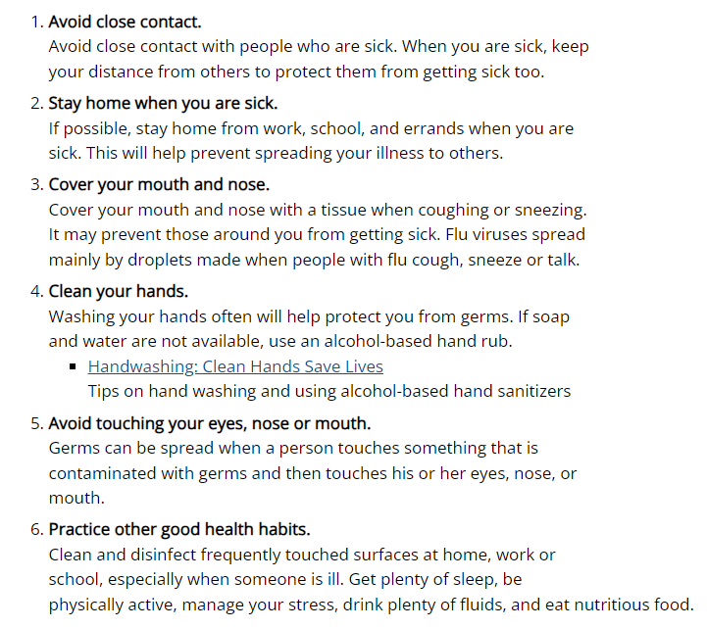
Other Tips and General Resources to help the spread of Germs !
Tricare Website
Masks and Respirators (cdc.gov)
Healthy Habits to Help Protect Against Flu | CDC

Slide 28
TRICARE – Open Season and Flu & COVID Vaccines

Slide 29
TRICARE® Open Season 2023
TRICARE is a registered trademark of the Department of Defense, Defense Health Agency. All rights reserved.
Confidential Information to be used only for integration planning purposes. Not for further distribution. Integration plan will be implemented only if regulatory approvals are obtained and transactions have closed.

Slide 30
TRICARE Open Season/Federal Open Season
TRICARE Open Season starts Nov. 13 and ends Dec. 12, 2023. Plan changes take effect Jan. 1, 2024.
Beneficiaries enrolled in or eligible for TRICARE Prime or TRICARE Select* can:
Stay in their current plan.
Enroll in a plan.
Change plans/switch between individual and family enrollment.
It’s important to keep DEERS up to date!
The Federal Benefits Open Season is for dental and vision coverage through the Federal Employees Dental and Vision Insurance Program (FEDVIP). It starts Nov. 13 and ends Dec. 11, 2023, with plan changes effective Jan. 1, 2024.
* TRICARE Open Season does not apply to TRICARE Reserve Select, TRICARE Retired Reserve or TRICARE Young Adult.

Slide 31
Immunizations
TRICARE covers age-appropriate vaccines, as recommended by the Centers for Disease Control and Prevention (CDC).
TRICARE covers vaccines at no cost.
Getting Vaccines:
Military Hospital or Clinic Contact your local military hospital or clinic for vaccine instructions and availability.
Authorized Provider You may have to pay copayments or cost-shares for the office visit or for other services received during the office visit, amounts vary according to your plan.
Network Pharmacies
You can get covered vaccines for $0 at participating network pharmacies.
To find a pharmacy that participates in the vaccine program:
Find a Pharmacy online or call 1-877-363-1303 to inquire if appointment is needed, or for more information.

Slide 32
Thank You
HS1023x202 (10/23)

Slide 33
Next meeting will be February 22, 2023 at 10:30 a.m.
Please follow us on Facebook, Instagram and our website (william-beaumont.tricare.mil/) for the latest news and updates.
Please contact the Patient Experience Department at
915-742-2692 for recommendations or questions or if you require assistance

Slide 34
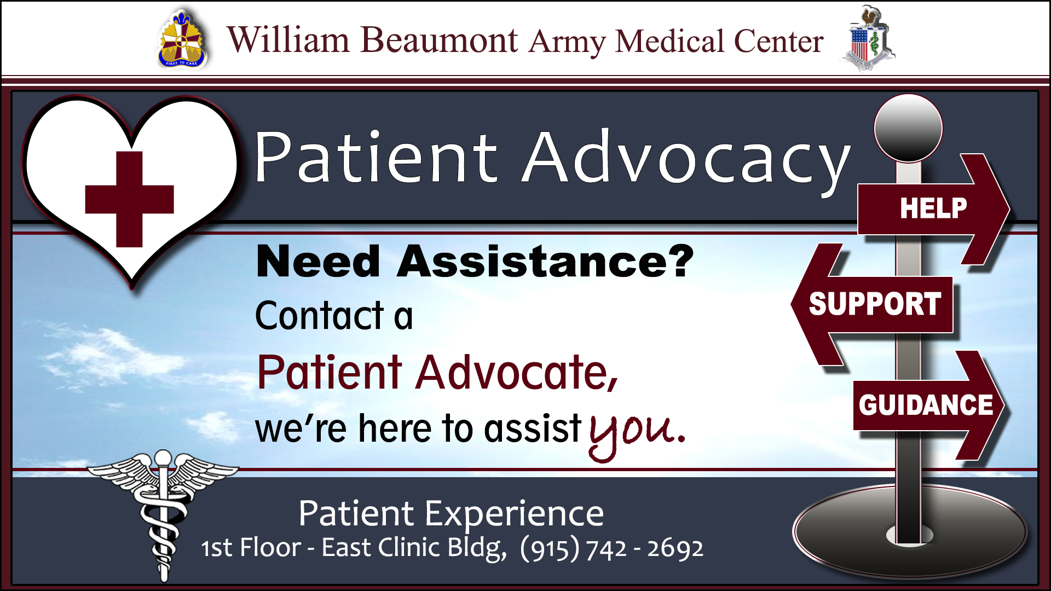

Slide 35
Questions and Discussion

